Slide 1

STYLE SPARKS
“stand out in style”

Slide 2
CONTENT
Introduction
Objectives
Scope
Tools
Hardware and Software
Data Flow Diagram
Class Diagram
Modules
Limitations
Future scope

Slide 3
INTRODUCTION
A Print-on-Demand is a business where you create and sell custom-designed products without keeping inventory. When a customer places an order, a third-party supplier prints your design on the product (like T-shirts, mugs, or phone cases) and ships it directly to them.
It is commonly used for selling customized accessories, books, and home decor.
POD services like printful and printfy integrate with e-commerce platforms such as shopify and esty, allowing entrepreneurs to sell without managing production or shipping.

Slide 4
OBJECTIVES
Low investment
Minimum risk
Scalability
Global reach
Automation
Eco friendly
Focus on creativity

Slide 5
SCOPE
E commerce growth
Wide product range
No inventory management
Global market access
Scalable business
Low startup cost
Drop shipping model

Slide 6
HARDWARE
Hardware Requirements:
Processor: 11th Gen Intel(R) Core(TM) i3-1115G @3.00GHz 2.90GHz
RAM: 8.00 GB
System type: 64-bit operating system, x64 based processor
Processor Edition: Windows 11 home single language
Version: 24H2
Hardware disk: 10GB

Slide 7
SOFTWARE
Software Requirements:
Operating System: Windows 11.
Programming language: php 5.6, php 7 for server-side scripting.
User Interface Design: HTML, CSS, JAVASCRIPT
Database: My SQL 5.x
Web Browser: Google chrome
Software: XAMPP

Slide 8
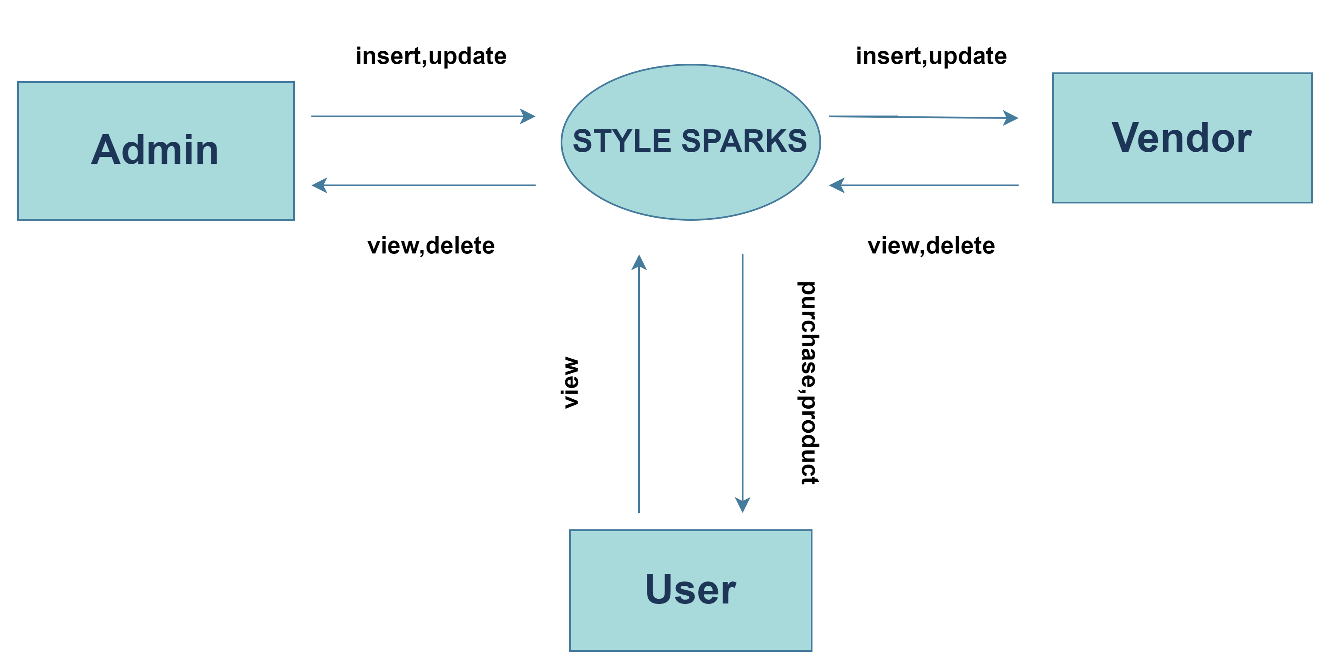
DATA FLOW DIAGRAM

Slide 9
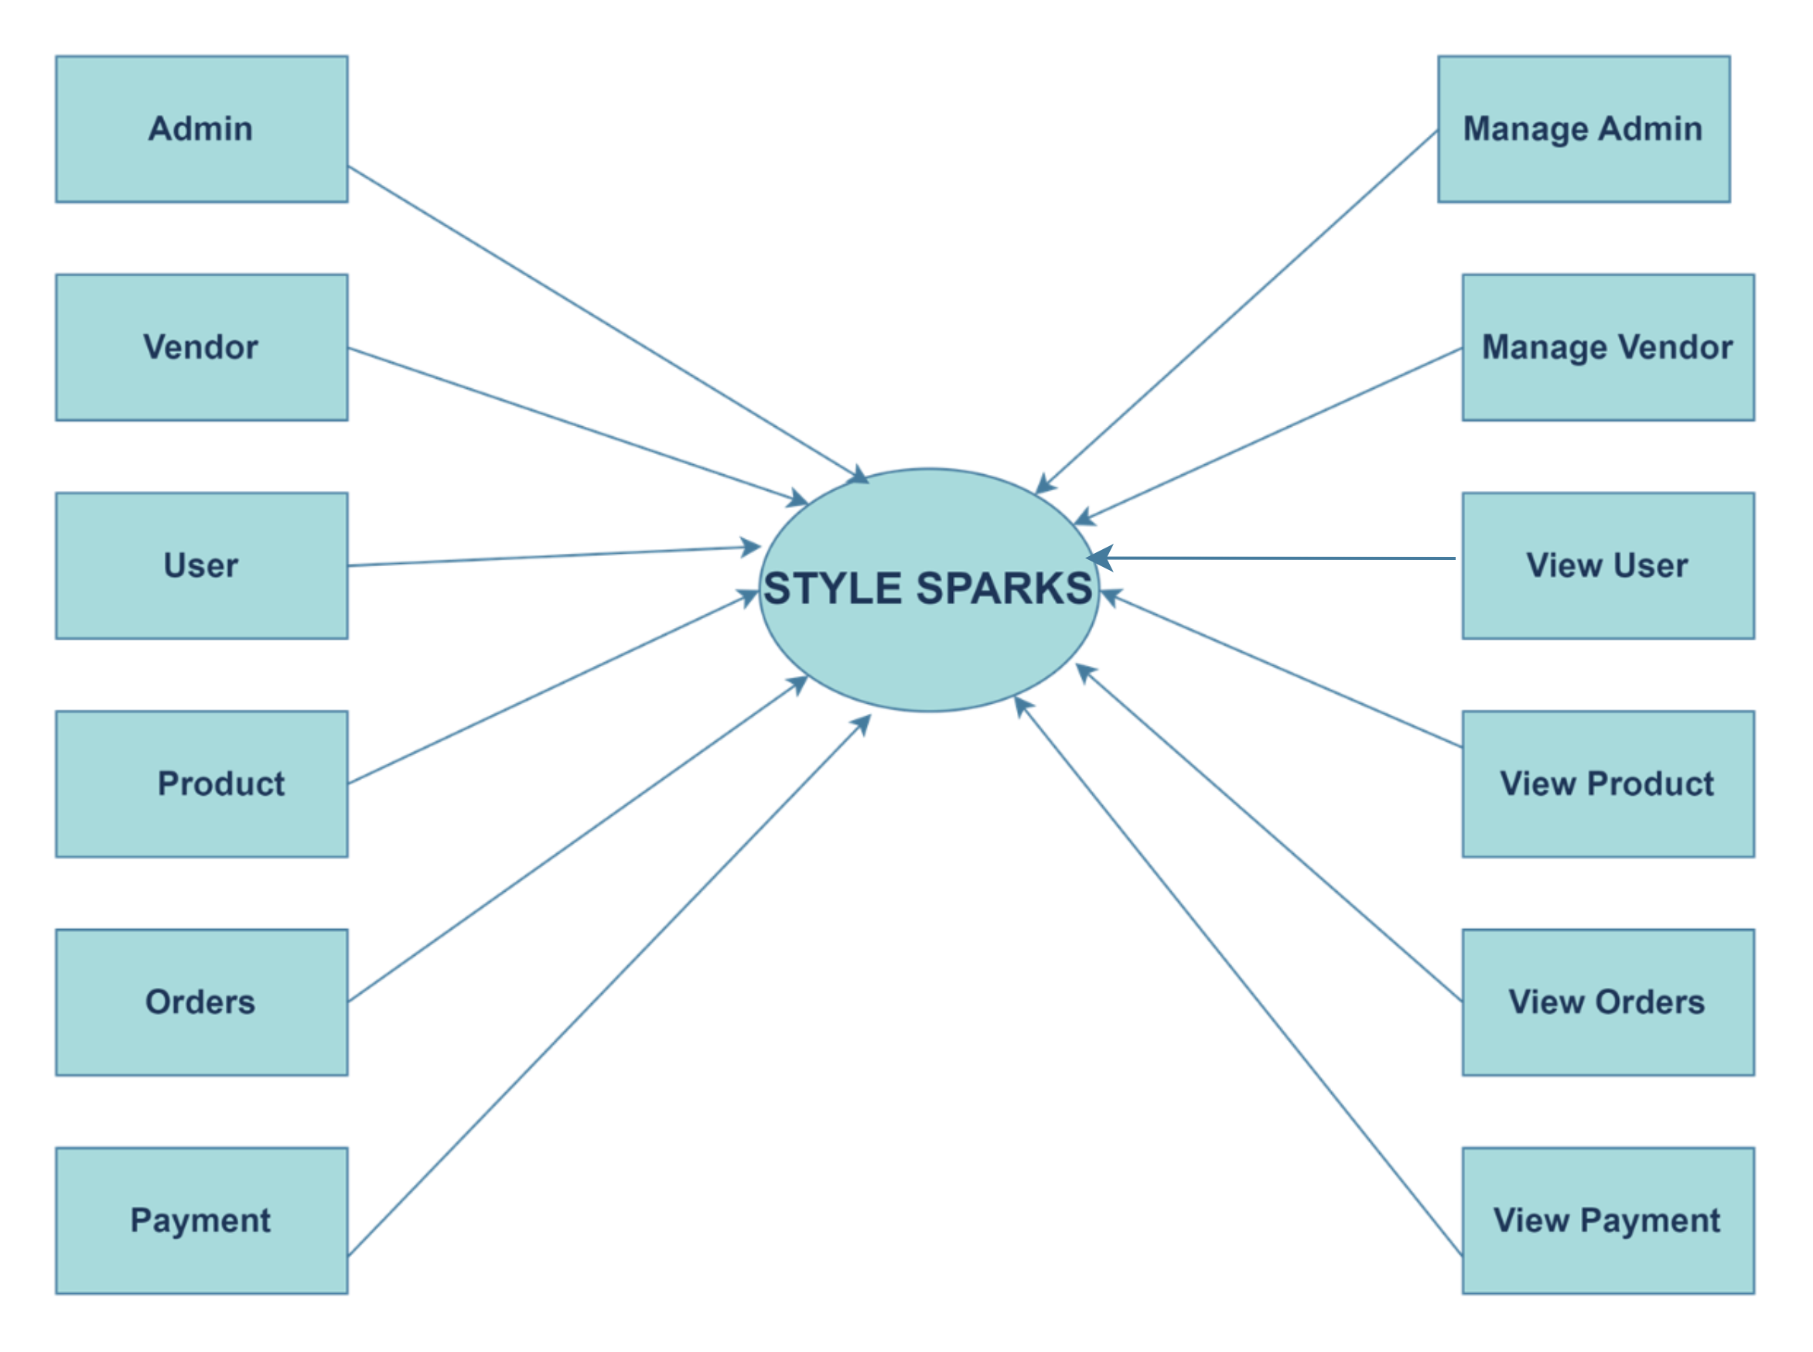

Slide 10
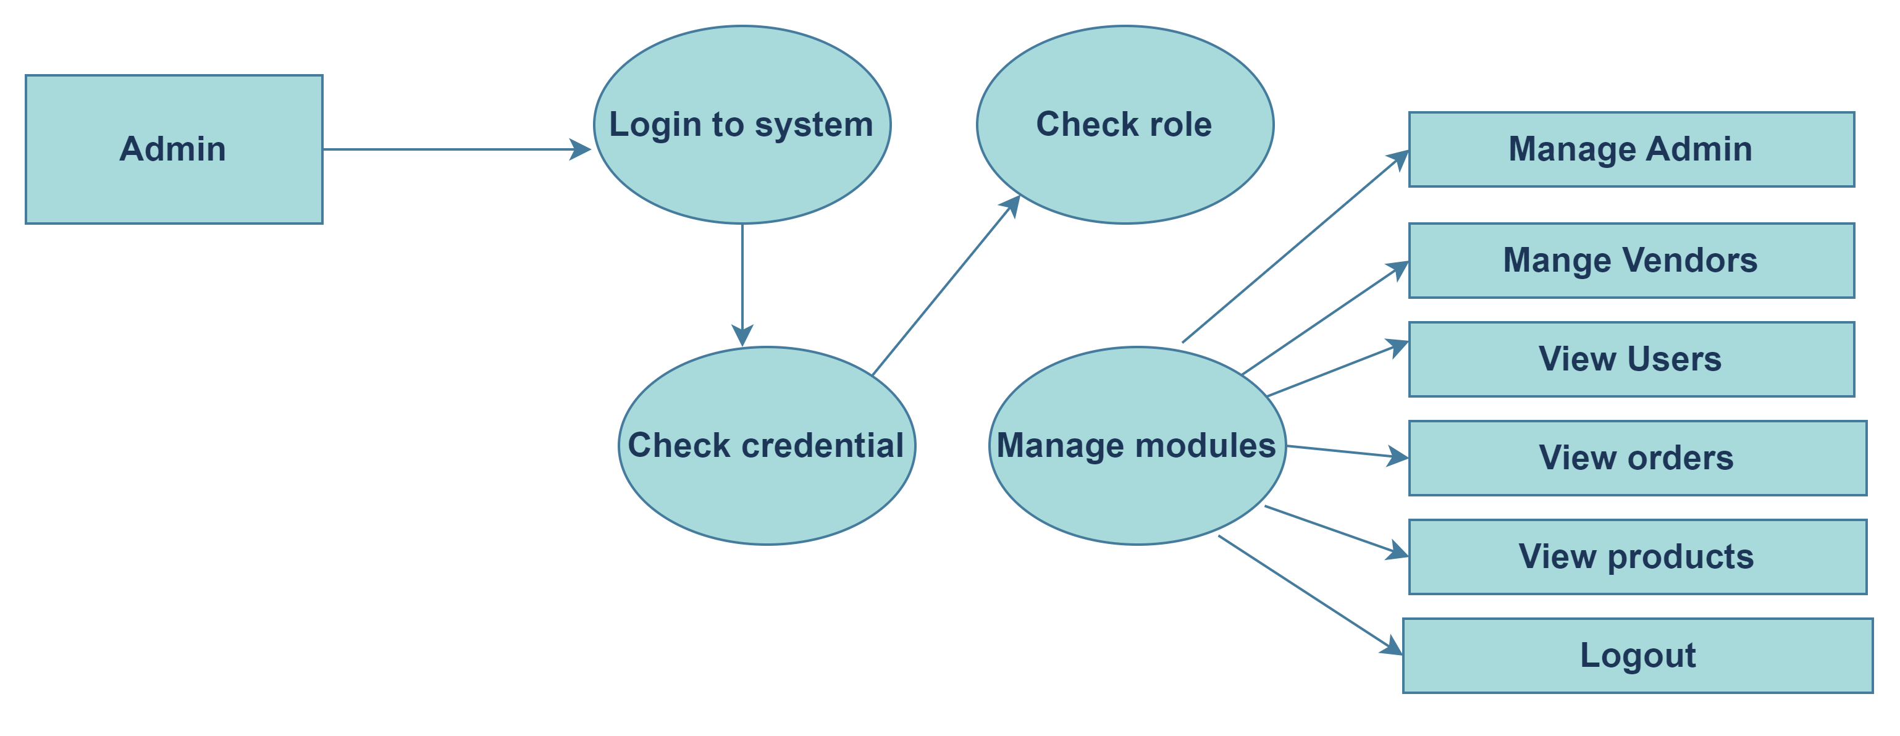

Slide 11


Slide 12
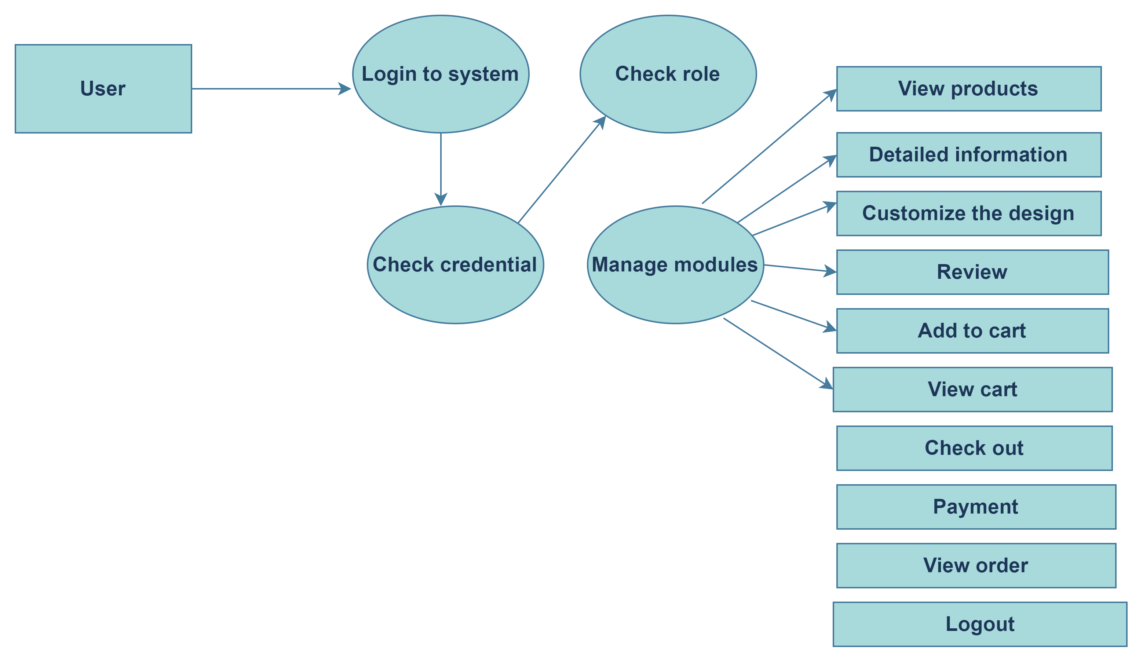

Slide 13
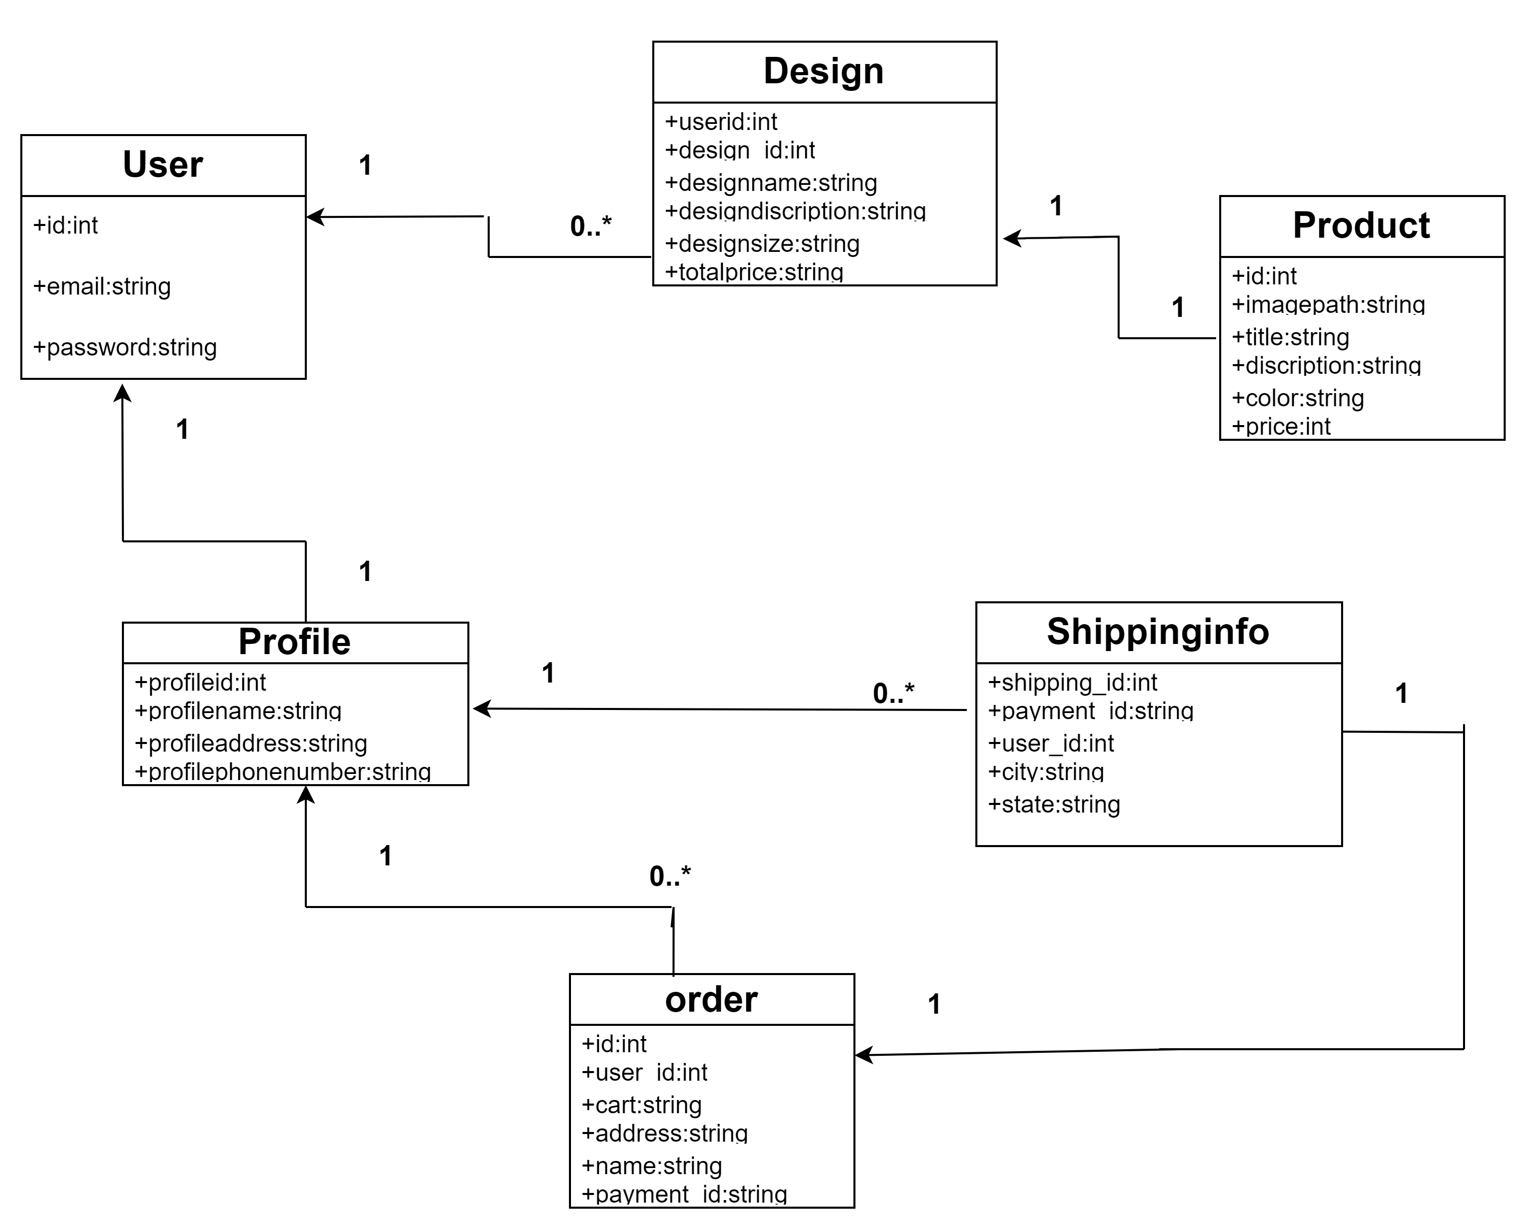
CLASS DIAGRAM

Slide 14
MODULES
Admin Module:
User Management: Handles creation, modification, and deletion of user accounts.
Order Management: Processes and tracks orders, handles returns and refunds.₌
System Configuration: Manages system settings, payment gateways, and notifications.

Slide 15
Vendor Module:
Design Management Process: Manages design data and updates.
Order Processing Process: Handles order fulfillment and status updates.

Slide 16
User Module:
Design Customization: Allows users to create and customize T-shirts,mugs,mobile,etc.
Order Placement: Manages cart, payment options, and order completion.
Order Tracking: Provides order status updates and tracking information.

Slide 17
LIMITATIONS
Lower profit margins
Limited customization
Quality control issues
Limited product range
Depend on third party providers
Platform and policy restructions

Slide 18
FUTURE SCOPE
Expansion of product offerings
Faster production and delivery
Eco friendly printing
AI and personalization
Integration with technologies
Global reach and multi-platform integration

Slide 19
Thank You.

